Slide 1


Team 37: Microhistological Analysis of the Dietary Habits of Sheep: GrazeView AI
Bi-Weekly Update 4
Godson Edewor, Arnav Gokhale, Jack Nelson, and Nate Scott Sponsor: John Lusher TA: Sabyasachi Gupta

Slide 2
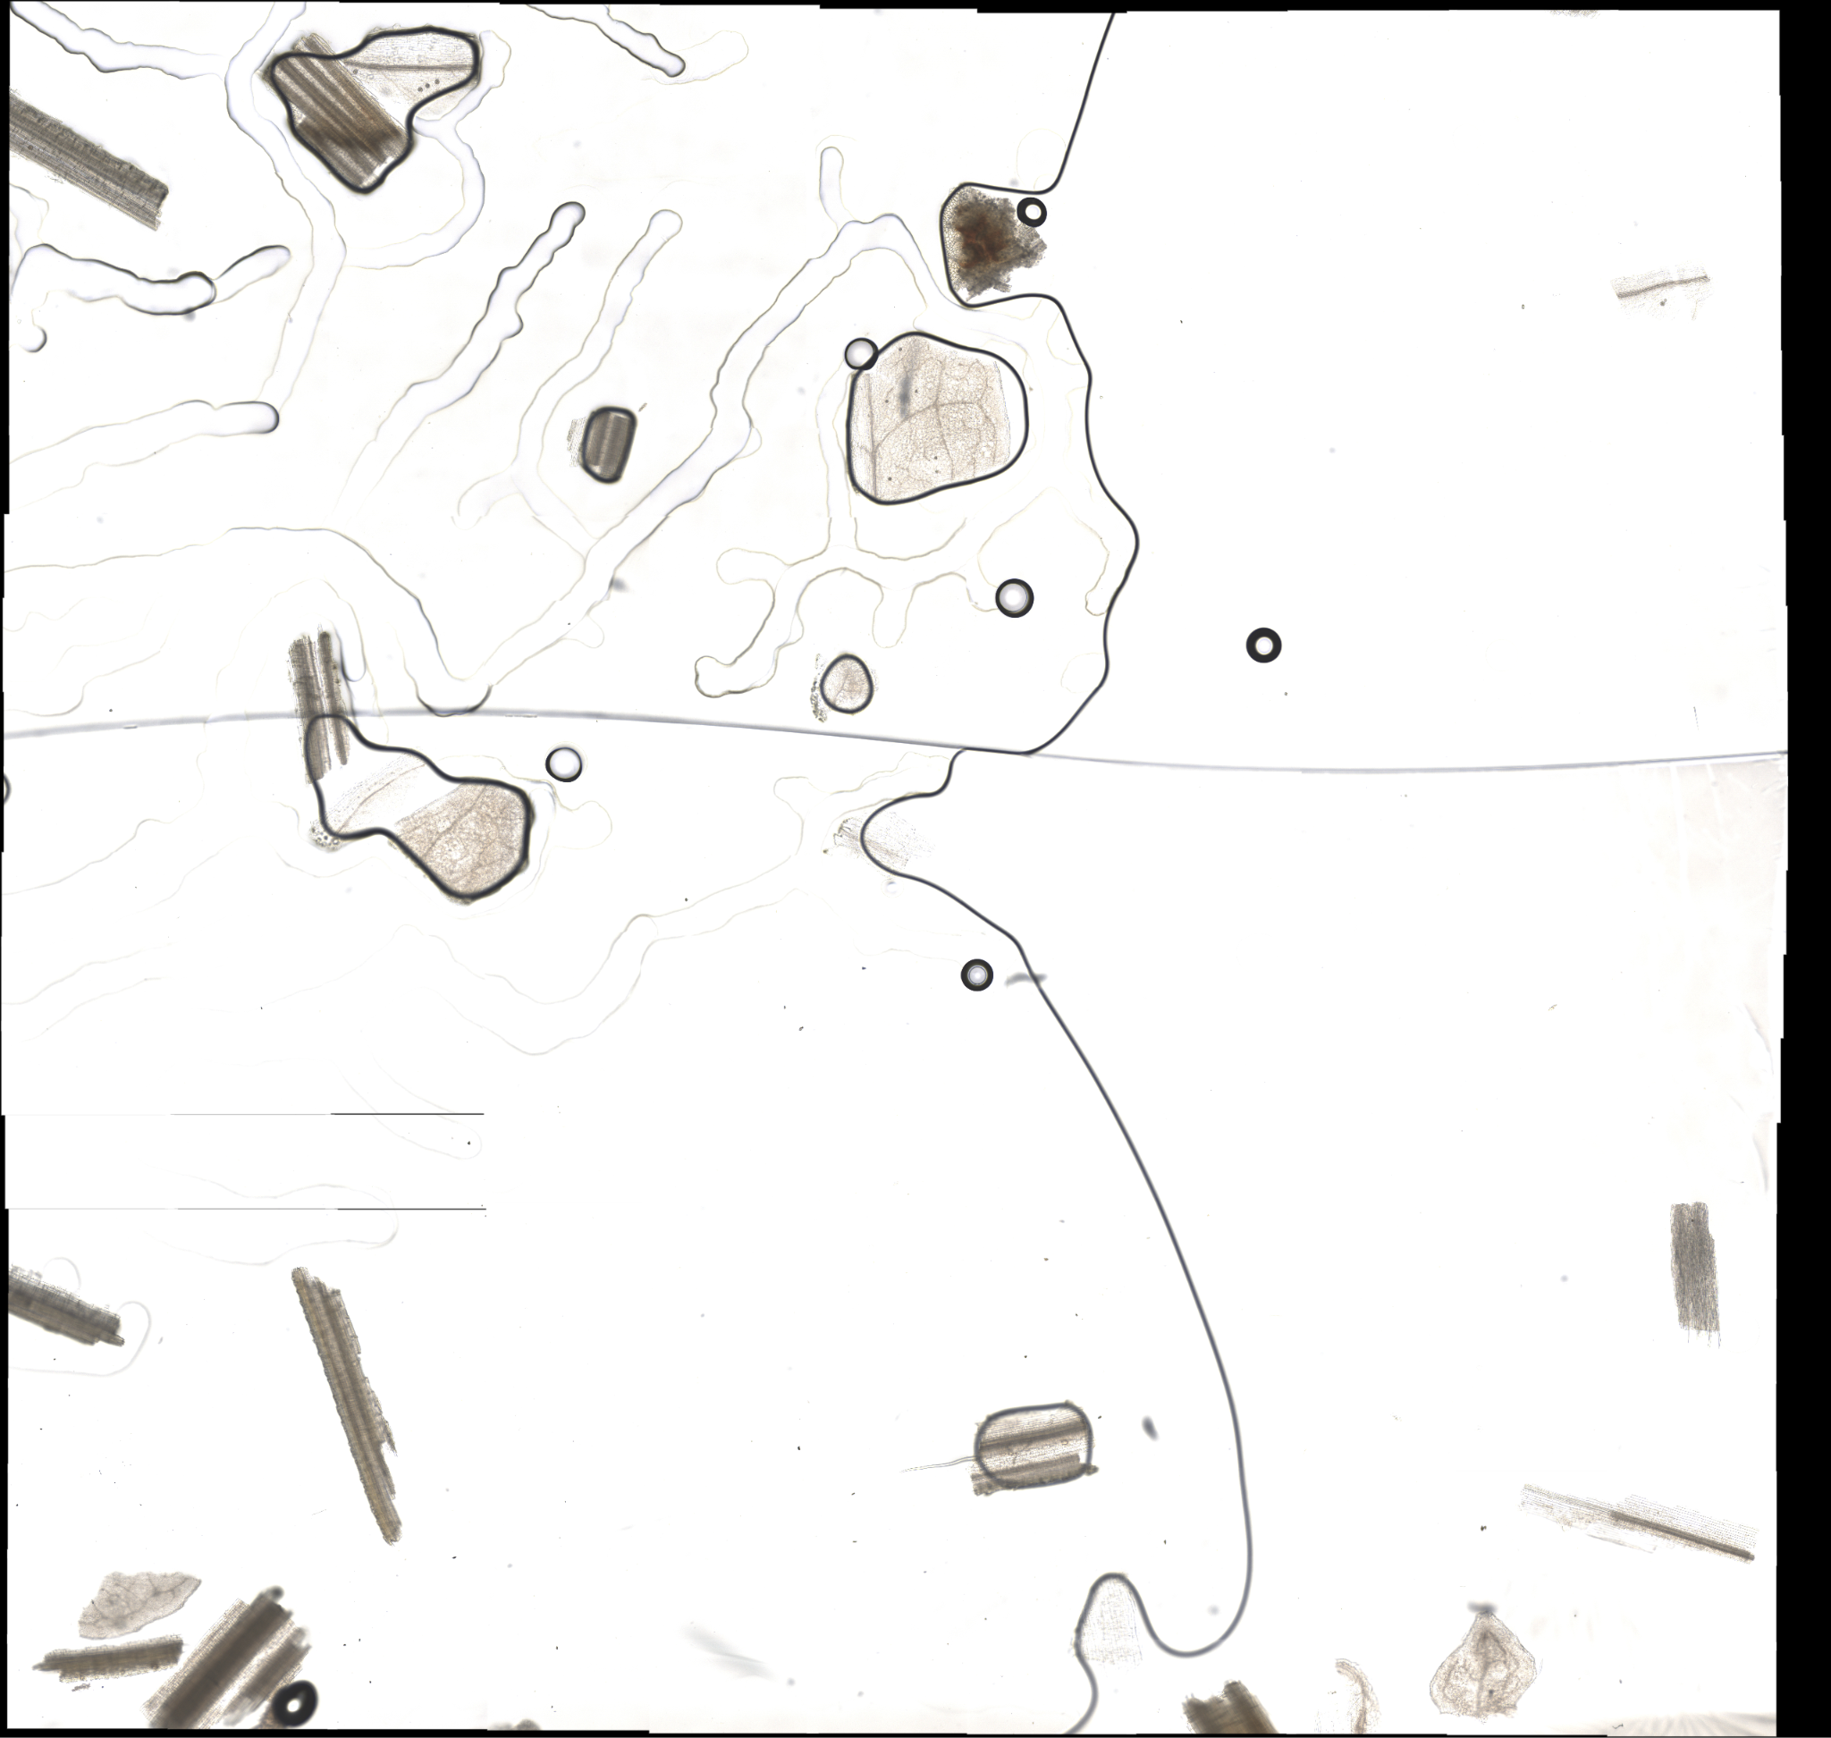
Project Summary
Problem Statement:
TAMU AgriLife is currently investigating the Dietary Habits of Sheep and the effect it has on their wool.
This can be a very time consuming effort, when analyzing microscopic samples by hand.
Solution Proposal:
GrazeView AI will allow the process of analyzing these microscope slides to become automated.
This will save TAMU AgriLife both time and money spent in training individuals that analyze by hand.

Slide 3
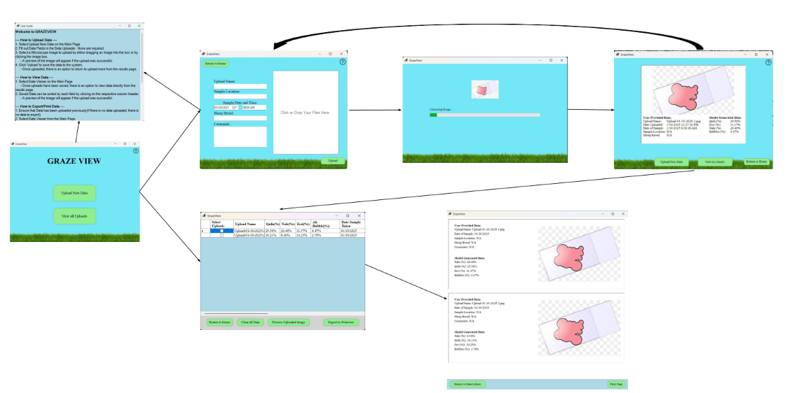
Integrated System Diagram

Slide 4
Project Timeline
Subsystem Final Validation (01/29) | Begin ML/UI Integration (02/03) | Finish ML/UI Integration Begin DB/UI Integration (02/17) | Finalize DB/UI Integration Fix Integration Errors (03/03) | Project-wide Validation (03/24) | Validate Until Demo | Demo and Report (04/16)
*All Dates represent completion

Slide 5
User Interface & Machine Learning
Godson Edewor, Jack Nelson, & Nate Scott
Accomplishments since last update [~20 Hours] | Ongoing progress/problems and plans until the next presentation
ML Model has been embedded within the application ML Results are stored within the Data Library in the UI ML outputs and UI results properly formatted C# and Python ONNX discrepancy resolved Successfully trained a 90% accuracy model with less than a 10% error rate | Run benchmarks against industry standards Maximize any remaining features (scalability)

Slide 6
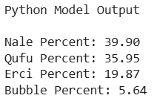
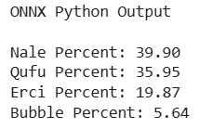
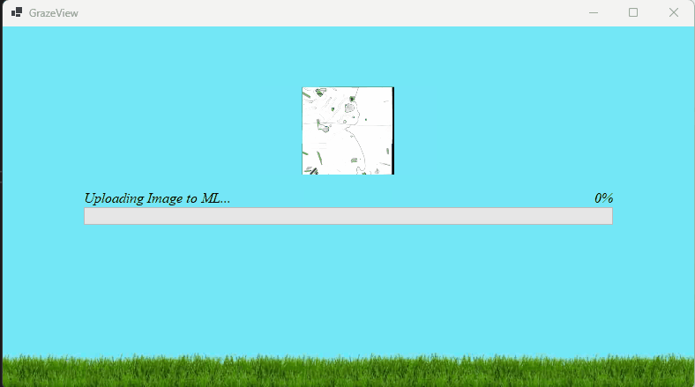
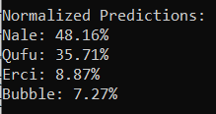
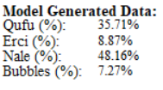
User Interface & Machine Learning
Godson Edewor, Jack Nelson, & Nate Scott

Slide 7
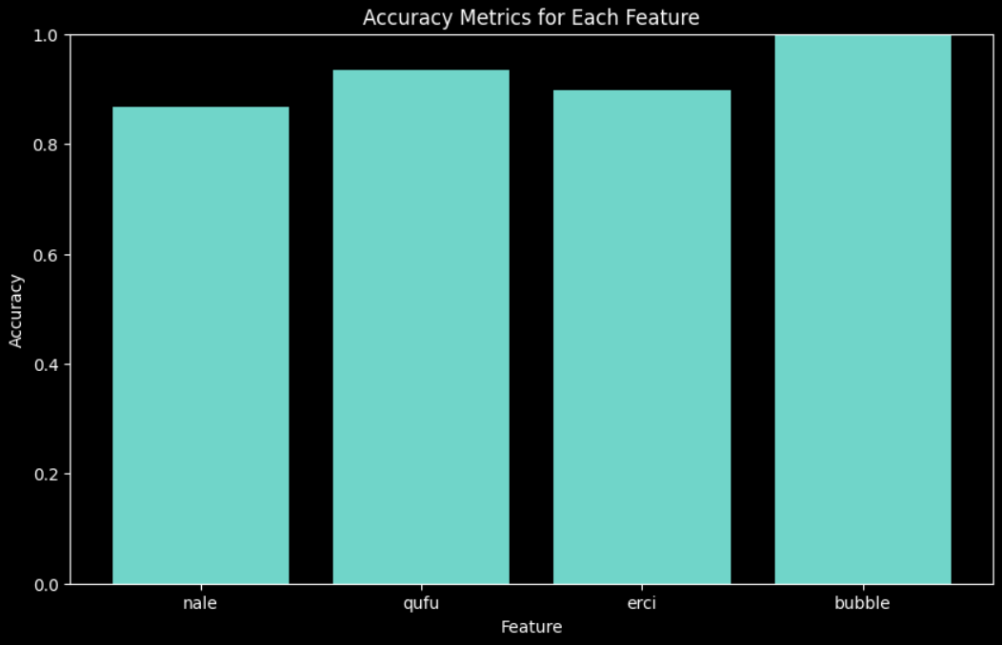
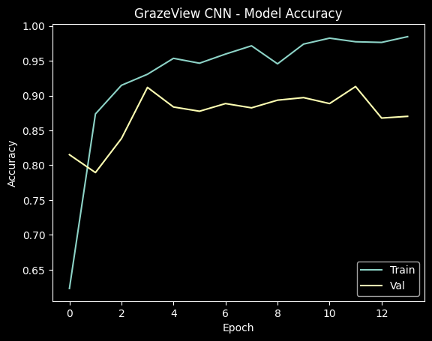
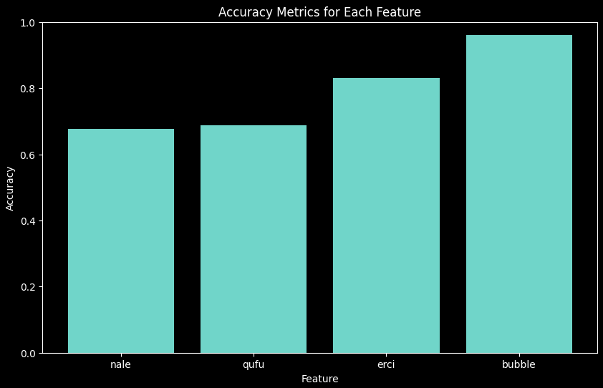
User Interface & Machine Learning
Godson Edewor, Jack Nelson, & Nate Scott

Slide 8
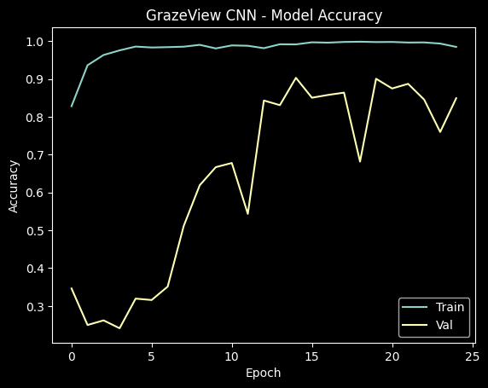
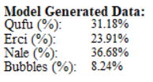
User Interface & Machine Learning
Godson Edewor, Jack Nelson, & Nate Scott

Slide 9
User Interface & Database
Full Team
Accomplishments since last update [~20 Hours] | Ongoing progress/problems and plans until the next presentation
Image DB fully functional CSV DB fully functional Integrated ML Results pushed to DB Tested DB content pulled in Dataviewer (UI) User can select files to view ex. “154HD_001” will display “154HD001.png” (image) & “154HD001.txt” (text - % split) in GrazeView Application | Further validation for image & CSV corresponding pull Clean up establish & terminate connection scripts Final debug

Slide 10
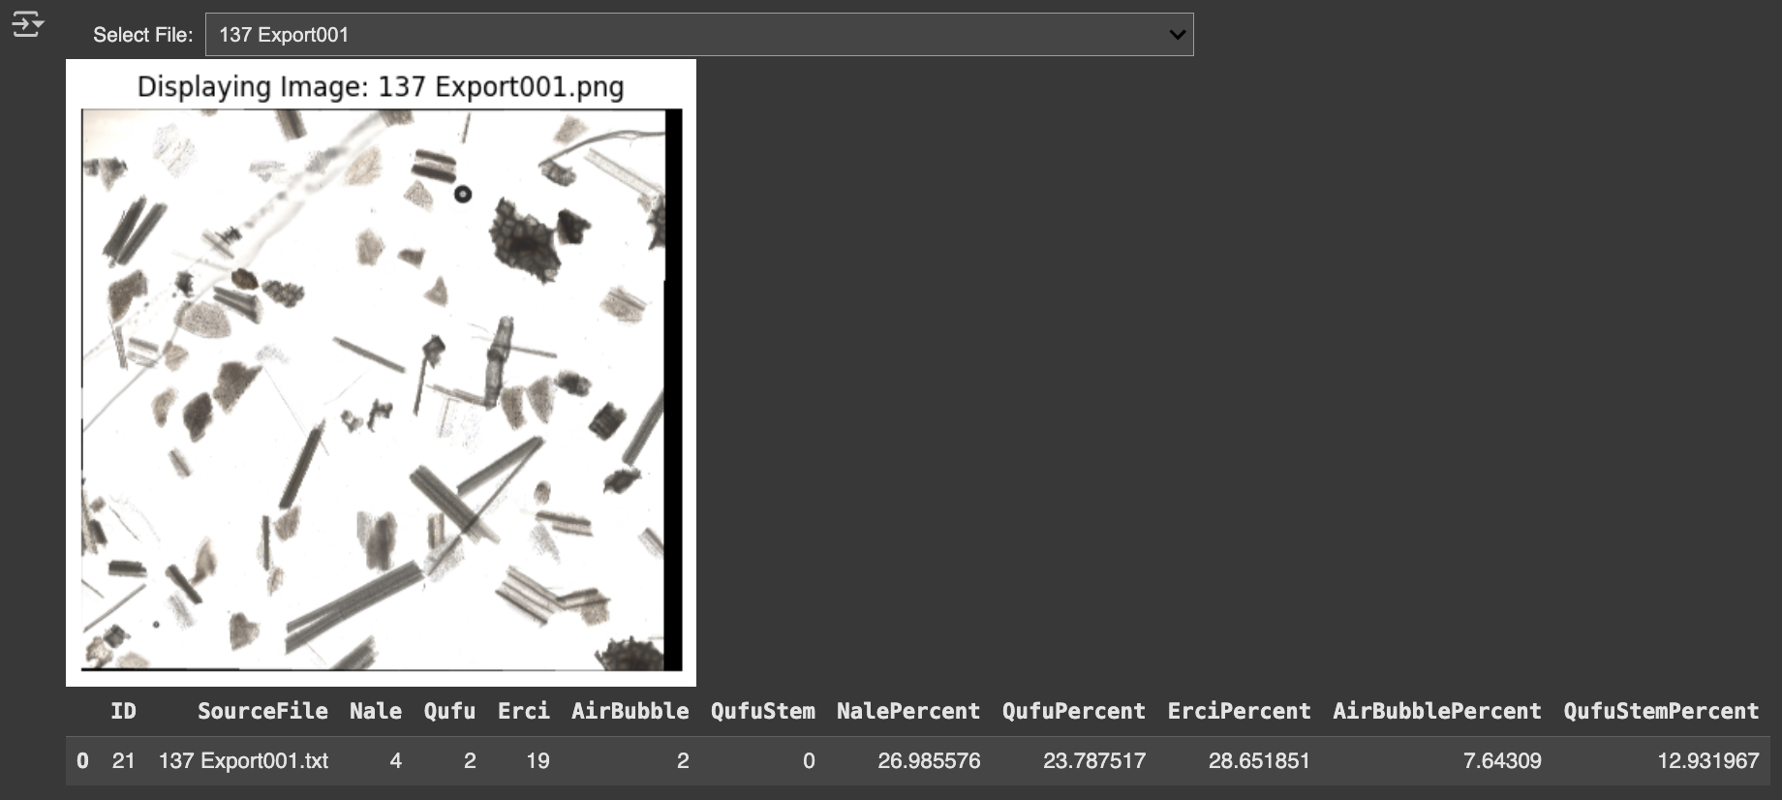
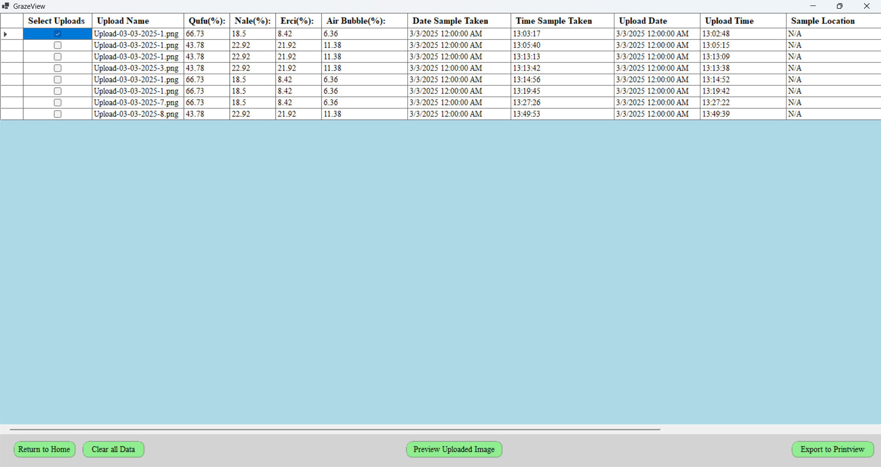
User Interface & Database
Full Team

Slide 11
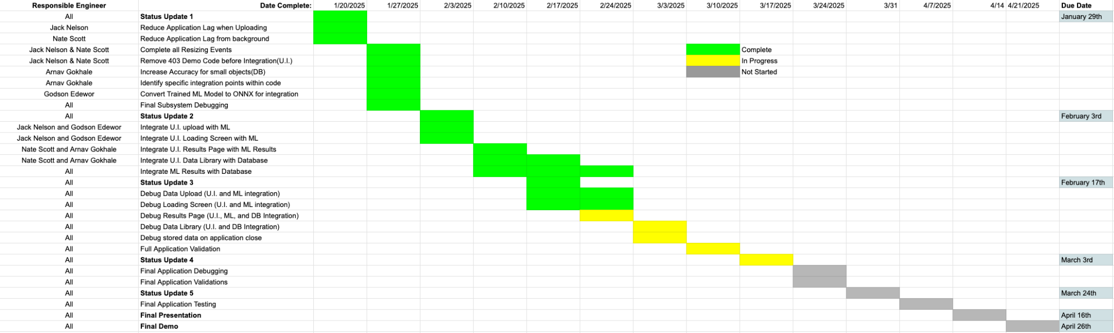
Execution Plan

Slide 12
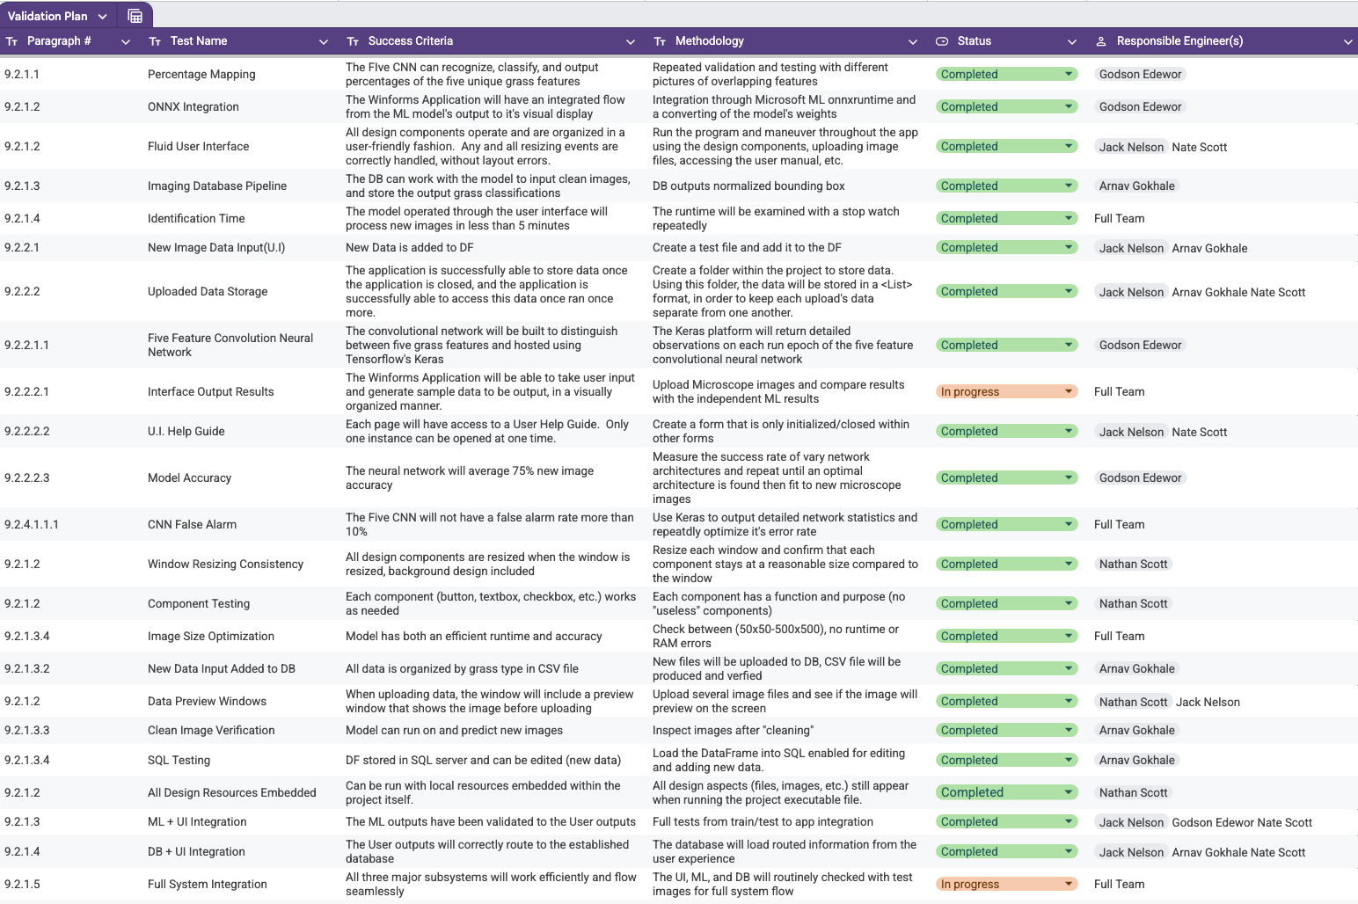
Validation Plan

Slide 13
Questions?

